Slide 1
Review-2 on Hand gesture recognition using American Sign Language (ASL)
Bollineni Chooshnitha 2010030487 (Team Leader)
Telugu Rohith 2010030201
Perla Nada Asish 2010030552
Under the Guidance of
Dr. Subhranginee Das
Professor
Computer Science and Engineering Department
KL Hyderabad Off Campus, Aziz Nagar ,Hyderabad

Slide 2
Overview
Introduction
Objectives of the Project
Proposed Methodology/Architecture/Algorithm/Technique/etc
Implementation Details
Results (If any one objective is completed)
References

Slide 3
Introduction
Hand sign detection is a subfield of computer vision that aims to recognize and interpret hand gestures made by individuals.
These gestures can convey various forms of communication, including sign language, commands in human-computer interaction systems, or expressions in augmented reality applications.
Hand sign detection plays a crucial role in enhancing accessibility for individuals with hearing or speech impairments by enabling them to communicate effectively through sign language.
Despite advancements in computer vision, hand sign detection poses several challenges.
These include variations in hand shapes, sizes, orientations, and movements, as well as complexities introduced by dynamic backgrounds, lighting conditions, occlusions, and inter-class similarities among different signs.

Slide 4
Objectives of the Project
Gesture Recognition: Detect and recognize different hand gestures accurately and Develop a system that can interpret the meaning of each gesture.
Real-time Processing: Achieve real-time processing for prompt and responsive interaction. Optimize algorithms and models to ensure low latency, enabling the system to quickly respond to changes in hand gestures.
Multimodal Integration: Explore the integration of multiple modalities, such as combining hand sign detection with voice recognition or facial expressions, to create a more comprehensive and versatile human-computer interaction system.
User Adaptability and Personalization: Develop mechanisms to adapt the hand sign detection system to individual users, considering variations in gesture styles, speeds, and preferences.

Slide 5
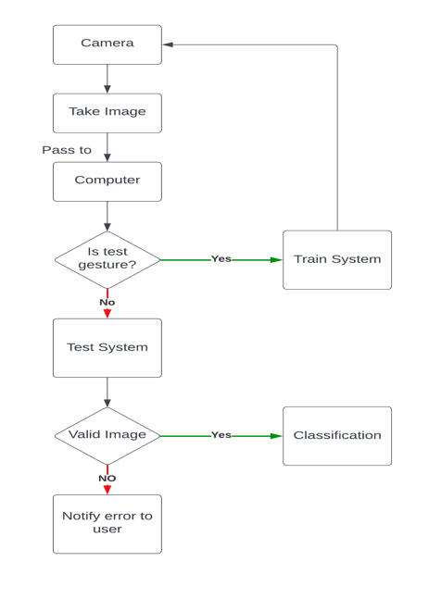
Proposed Algorithm

Slide 6
Objectives of the Project
1. Design and implement a robust hand gesture recognition algorithm capable of accurately detecting and classifying various hand gestures in real-time.
2. Develop a dataset comprising diverse hand gestures to train and validate the recognition model, ensuring its effectiveness across different users and environments.
3. Optimize the algorithm for efficiency to enable real-time performance on resource-constrained hardware platforms, facilitating seamless integration into various applications.
4. Enhance the system's robustness to environmental factors such as changes in lighting conditions, background clutter, and variations in hand orientation and size.
5. Validate the system's performance through rigorous testing and evaluation, comparing its accuracy, speed, and reliability against existing approaches and benchmarks.
6. Explore potential applications of the hand gesture recognition system, such as sign language translation, virtual reality interaction, and gesture-based control interfaces.
7. Document the development process, including methodology, challenges faced, and lessons learned, to facilitate future research and development in the field of human-computer interaction and computer vision.
Gesture Recognition: Detect and recognize different hand gestures accurately and Develop a system that can interpret the meaning of each gesture.
Real-time Processing: Achieve real-time processing for prompt and responsive interaction. Optimize algorithms and models to ensure low latency, enabling the system to quickly respond to changes in hand gestures.
Multimodal Integration: Explore the integration of multiple modalities, such as combining hand sign detection with voice recognition or facial expressions, to create a more comprehensive and versatile human-computer interaction system.
User Adaptability and Personalization: Develop mechanisms to adapt the hand sign detection system to individual users, considering variations in gesture styles, speeds, and preferences.

Slide 7
Implementation Details
Data Collection: Capture images of hands forming different signs (e.g., a, b, and c). Create separate folders to store images of each sign. Ensure that the images have a consistent background and lighting. Collect around 300 images for each sign.
Training the Classifier: Use a tool like Google Teachable Machine to train a classifier model. Upload the collected images to the Teachable Machine website. Label the images according to the corresponding signs (a, b, and c). Train the model and wait for it to complete.
Testing the Model: Import the trained model into your Python code. Use OpenCV library functions to manipulate and display images. Write code to detect the hand region in an image frame. Pre-process the image by resizing it to a square and adding a white background. Use the trained model to predict the sign in the image frame. Display the image with the predicted sign and bounding box around the hand.

Slide 8
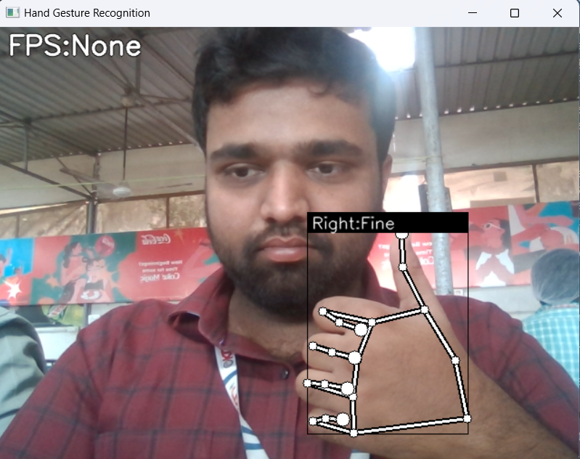
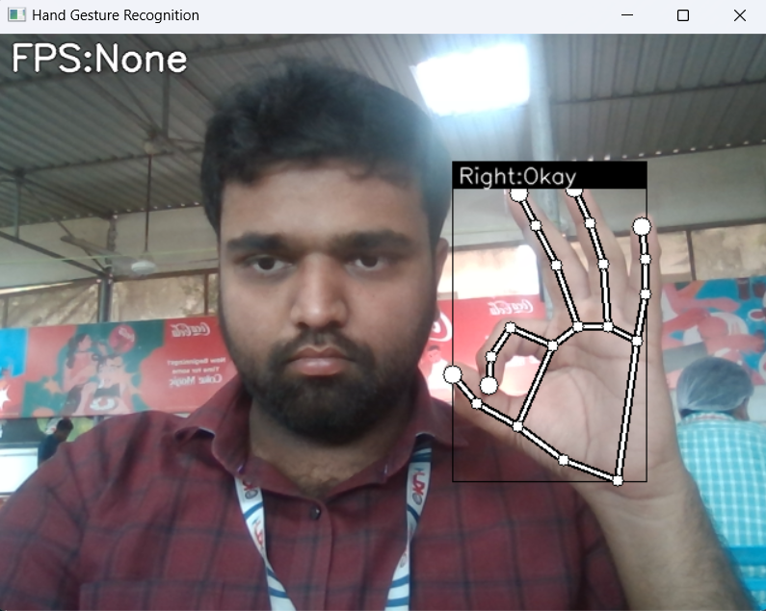
Results

Slide 9
References
"Static Hand Gesture Recognition Using Novel Convolutional Neural Network and Support Vector Machine" (July 2023)
"An Exploration into Human–Computer Interaction: Hand Gesture Recognition Management in a Challenging Environment" (June 2023)
"Smart Home Automation-Based Hand Gesture Recognition Using Feature Fusion and Recurrent Neural Network" (2023)
"Lightweight Deep Neural Network for Real-Time Hand Gesture Recognition Using Depth Images" (2023)
EP

Slide 10
Thank you and Any Queries

